Slide 1


KGiSL Institute of Technology
(Approved by AICTE, New Delhi; Affiliated to Anna University, Chennai)
Recognized by UGC, Accredited by NBA (IT)
365, KGiSL Campus, Thudiyalur Road, Saravanampatti, Coimbatore – 641035.
Department of Computer Science and Business systems
Name of the Faculty : V.Sivaranjani
Subject Name & Code : CCS335 CLOUD COMPUTING
Branch & Department : CSBS
Year & Semester : III&VI
Academic Year :2023-2024

Slide 2
KGiSL Institute of Technology
(Approved by AICTE, New Delhi; Affiliated to Anna University, Chennai)
Recognized by UGC, Accredited by NBA (IT)
365, KGiSL Campus, Thudiyalur Road, Saravanampatti, Coimbatore – 641035.
COURSE OBJECTIVES:
To understand the principles of cloud architecture, models and infrastructure.
To understand the concepts of virtualization and virtual machines.
To gain knowledge about virtualization Infrastructure.
To explore and experiment with various Cloud deployment environments.
To learn about the security issues in the cloud environment.

Slide 3
KGiSL Institute of Technology
(Approved by AICTE, New Delhi; Affiliated to Anna University, Chennai)
Recognized by UGC, Accredited by NBA (IT)
365, KGiSL Campus, Thudiyalur Road, Saravanampatti, Coimbatore – 641035.
COURSE OUTCOMES:
CO1: Understand the design challenges in the cloud.
CO2: Apply the concept of virtualization and its types.
CO3: Experiment with virtualization of hardware resources and Docker.
CO4: Develop and deploy services on the cloud and set up a cloud environment.
CO5: Explain security challenges in the cloud environment.

Slide 4
KGiSL Institute of Technology
(Approved by AICTE, New Delhi; Affiliated to Anna University, Chennai)
Recognized by UGC, Accredited by NBA (IT)
365, KGiSL Campus, Thudiyalur Road, Saravanampatti, Coimbatore – 641035.
UNIT I CLOUD ARCHITECTURE MODELS AND INFRASTRUCTURE
Cloud Architecture: System Models for Distributed and Cloud Computing – NIST Cloud Computing Reference Architecture – Cloud deployment models – Cloud service models; Cloud Infrastructure: Architectural Design of Compute and Storage Clouds – Design Challenges

Slide 5
KGiSL Institute of Technology
(Approved by AICTE, New Delhi; Affiliated to Anna University, Chennai)
Recognized by UGC, Accredited by NBA (IT)
365, KGiSL Campus, Thudiyalur Road, Saravanampatti, Coimbatore – 641035.
System Models for Distributed and Cloud Computing
Distributed and cloud computing systems are built over a large number of autonomous computer nodes. These node machines are interconnected by SANs, LANs, or WANs
LAN
It is the type of networking system in which systems are very near to each other. This system is generally in a single office, building or home.
Computer networks of schools, homes, offices, hospitals, etc. are the common examples of LANs.
WAN:This networking system has many connections, and these are associated with various companies or organizations at an equivalent time. A bank, including its branch offices and ATM machines, is another example of an organization using a WAN. The branches may be in multiple states, or even global locations, but they are all linked through various secure connections.
Computer networks that cover an entire city, or globe like internet are the examples WANs.
A Storage Area Network (SAN) is a network of storage devices that can be accessed by multiple servers or computers, providing a shared pool of storage space. Each computer on the network can access storage on the SAN as though they were local disks connected directly to the computer.
https://youtu.be/3yZDDr0JKVc?si=2t4spllrbp5I7vzS -NAS vs SAN

Slide 6
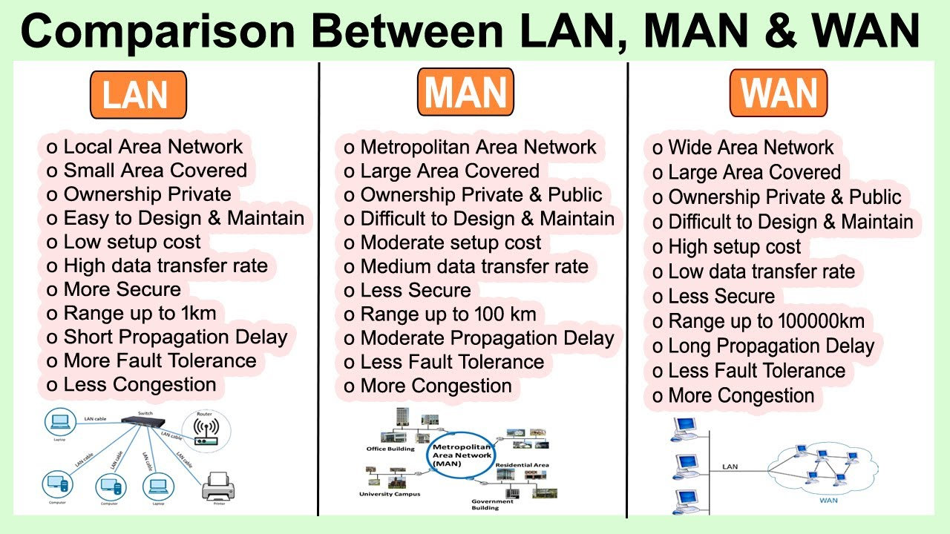
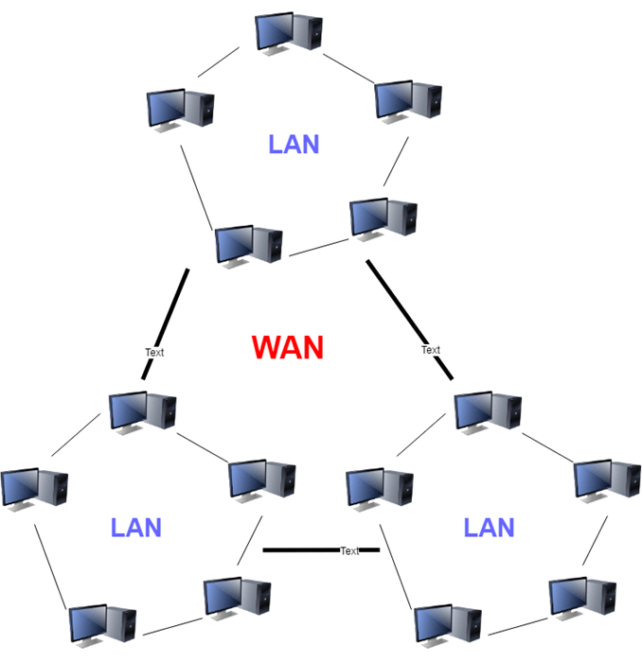
KGiSL Institute of Technology
(Approved by AICTE, New Delhi; Affiliated to Anna University, Chennai)
Recognized by UGC, Accredited by NBA (IT)
365, KGiSL Campus, Thudiyalur Road, Saravanampatti, Coimbatore – 641035.

Slide 7
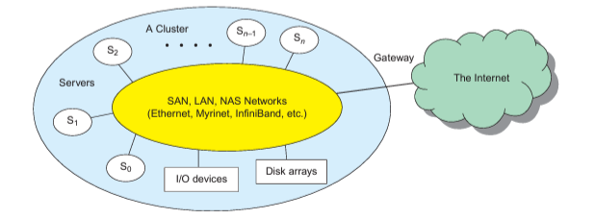
KGiSL Institute of Technology
(Approved by AICTE, New Delhi; Affiliated to Anna University, Chennai)
Recognized by UGC, Accredited by NBA (IT)
365, KGiSL Campus, Thudiyalur Road, Saravanampatti, Coimbatore – 641035.
With today’s networking technology, a few LAN switches can easily connect hundreds of machines as a working cluster. A WAN can connect many local clusters to form a very large cluster of clusters. Massive systems are considered highly scalable, and can reach web-scale connectivity, either physically or logically.
Massive systems are classified into four groups:
Cluster computing https://youtu.be/Fsw2UYp5NSE?si=SBu6tvEzypYZX3ql - Cluster in tamil
Cluster computing is a set of computers connected via a network. This set of computers together form a single system and executes operations altogether. Clustering solves complicated problems with much faster computational speed. It gives better data integrity than a single computer.
Google search engine, Earthquake simulations, Weather forecasting uses clustering techniques.
https://youtu.be/E8WIIK0mxE8?si=9R5L7llfGg0nsXh1 –cluster computing

Slide 8

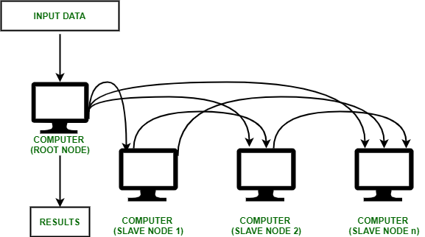
Cluster computing is a collection of tightly or loosely connected computers that work together so that they act as a single entity. The connected computers execute operations all together thus creating the idea of a single system. The clusters are generally connected through fast local area networks (LANs).
Cluster Computing Architecture :
It is designed with an array of interconnected individual computers and the computer systems operating collectively as a single standalone system.
It is a group of workstations or computers working together as a single, integrated computing resource connected via high speed interconnects.
A node – Either a single or a multiprocessor network having memory, input and output functions and an operating system.
Two or more nodes are connected on a single line or every node might be connected individually through a LAN connection.

Slide 9
Cluster management software maximizes the work that a cluster of computers can perform. A cluster manager balances workload to reduce bottlenecks, monitors the health of the elements of the cluster, and manages failover when an element fails. A cluster manager can also help a system administrator to perform administration tasks on elements in the cluster (by rerouting workload off of a computer that needs to be serviced, for example.)
List of software for cluster management.
Free and open source
Proxmox
Docker Swarm
Red Hat cluster suite
OpenShift and OKD, from Red Hat
Nomad, from HashiCorp
Rancher, from Rancher Labs

Slide 10
Types of Cluster computing :
High performance (HP) clusters :
An HPC cluster, or high-performance computing cluster, is a combination of specialized hardware, including a group of large and powerful computers, and a distributed processing software framework configured to handle massive amounts of data at high speeds with parallel performance and high availability.
2. Load-balancing clusters :
Incoming requests are distributed for resources among several nodes running similar programs or having similar content. This prevents any single node from receiving a disproportionate amount of task. This type of distribution is generally used in a web-hosting environment.
3. High Availability (HA) Clusters :
HA clusters are designed to maintain redundant nodes that can act as backup systems in case any failure occurs. Consistent computing services like business activities, complicated databases, customer services like e-websites and network file distribution are provided. They are designed to give uninterrupted data availability to the customers.
Classification of Cluster :
1. Open Cluster :IPs are needed by every node and those are accessed only through the internet or web. This type of cluster causes enhanced security concerns.
2. Close Cluster :The nodes are hidden behind the gateway node, and they provide increased protection. They need fewer IP addresses and are good for computational tasks.

Slide 11
Advantages of Cluster Computing :
1. High Performance : The systems offer better and enhanced performance than that of mainframe computer networks.
2. Easy to manage :Cluster Computing is manageable and easy to implement.
3. Scalable :Resources can be added to the clusters accordingly.
4. Expandability :
Computer clusters can be expanded easily by adding additional computers to the network. Cluster computing is capable of combining several additional resources or the networks to the existing computer system.
5. Availability :
The other nodes will be active when one node gets failed and will function as a proxy for the failed node. This makes sure for enhanced availability.
6. Flexibility :
It can be upgraded to the superior specification or additional nodes can be added.
Disadvantages of Cluster Computing : 1. Problem in finding fault :It is difficult to find which component has a fault.
2. More space is needed :Infrastructure may increase as more servers are needed to manage and monitor.

Slide 12
GRID COMPUTING
Grid computing is a form of parallel computing where large computational tasks are divided into smaller sub-tasks that can be executed simultaneously on different computers connected over a network.
This network can be a local area network (LAN), a wide area network (WAN), or even the internet.
The goal of grid computing is to increase the processing power available to users, making it possible to tackle larger and more complex computational problems.
How Does Grid Computing Work?
Grid computing is based on the idea of breaking down large computational tasks into smaller subtasks that can be executed in parallel.Each computer in the grid contributes its processing power to the overall effort.
When a user submits a job to the grid, the task is divided into smaller subtasks and each subtask is sent to a different computer for processing.
The results from each computer are then combined to produce the final result.
Benefits of Grid Computing
There are many benefits to using grid computing, including increased processing power, improved resource utilization, and reduced costs.
By tapping into the power of multiple computers, grid computing makes it possible to tackle larger and more complex computational problems.
It also allows organizations to share computing resources, reducing the need for each organization to invest in expensive hardware and software.

Slide 13
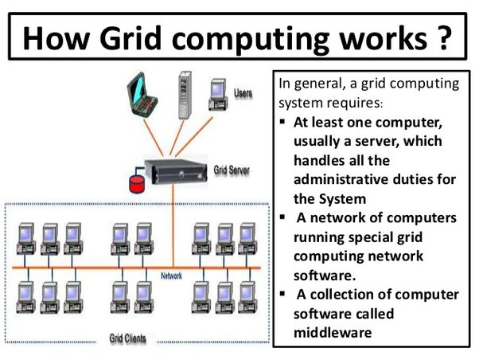
Applications of Grid Computing
Healthcare
Grid computing is being increasingly used in the healthcare industry to store and analyze massive amounts of patient data. This can be used to develop personalized medicine, improve medical research, or even help with disease outbreak detection and management.
Weather Forecasting
Weather forecasting requires massive amounts of data and computing resources to analyze and model weather patterns. Grid computing can be used to process the vast amounts of data generated by weather sensors and satellites in real-time to make more accurate weather predictions.

Slide 14
Middleware:
Middleware is software that lies between an operating system and the applications running on it. Essentially functioning as hidden translation layer, middleware enables communication and data management for distributed applications.
Grid computing operates by running specialized software on every computer involved in the grid network. The software coordinates and manages all the tasks of the grid.
Fundamentally, the software segregates the main task into subtasks and assigns the subtasks to each computer. This allows all the computers to work simultaneously on their respective subtasks.
Upon completion of the subtasks, the outputs of all computers are aggregated to complete the larger main task.
The software allows computers to communicate and share information on the portion of the subtasks being carried out. As a result, the computers can consolidate and deliver a combined output for the assigned main task.
Grid computing can be viewed as a subset of distributed computing, where a virtual supercomputer integrates the resources of several independent computers that are distributed across geographies.
Computers participating in a grid contribute resources such as processing power, network bandwidth, and storage capacity to perform operations requiring high computational power. The overall grid architecture looks like a single computing entity.

Slide 15
In grid computing, each computing task is broken into small fragments and distributed across computing nodes for efficient execution. Each fragment is processed in parallel, and, as a result, a complex task is accomplished in less time. Let’s consider this equation:
X = (4 x 7) + (3 x 9) + (2 x 5)
Typically, on a desktop computer, the steps needed here to calculate the value of X may look like this:
Step 1: X = 28 + (3 x 9) + (2 x 5)
Step 2: X = 28 + 27 + (2 x 5)
Step 3: X = 28 + 27 + 10
Step 4: X = 65
However, in a grid computing setup, the steps are different as three processors or computers calculate different pieces of the equation separately and combine them later. The steps look like this:
Step 1: X = 28 + 27 + 10
Step 2: X = 65
As seen above, grid computing combines the involved steps due to the multiplicity of available resources. This implies fewer steps and shorter timeframes.
https://youtu.be/r8ylJ16B0KQ?si=brnL3O5QGKCtkD74 – GRID COMPUTING
https://youtu.be/HJiXLDItJSY?si=9CYBf65b_YWwmFfH – DISTRIBUTED,CLUSTER,GRID,CLOUD COMPUTING
https://youtu.be/k6XqOiw4QSo?si=_TklWVpIbEXw3DVD – Comparison of cluster,grid and cloud computing

Slide 16
How does grid computing work?
Grid nodes and middleware work together to perform the grid computing task. In grid operations, the three main types of grid nodes perform three different roles.
User node
A user node is a computer that requests resources shared by other computers in grid computing. When the user node requires additional resources, the request goes through the middleware and is delivered to other nodes on the grid computing system.
Provider node
In grid computing, nodes can often switch between the role of user and provider.
A provider node is a computer that shares its resources for grid computing. When provider machines receive resource requests, they perform subtasks for the user nodes, such as forecasting stock prices for different markets. At the end of the process, the middleware collects and compiles all the results to obtain a global forecast.
Control node
A control node administers the network and manages the allocation of the grid computing resources. The middleware runs on the control node. When the user node requests a resource, the middleware checks for available resources and assigns the task to a specific provider node.

Slide 17
CCS335 CLOUD COMPUTING
Difference between Cluster and Grid Computing:
cluster Computing | Grid Computing
Nodes must be homogeneous i.e. they should have same type of hardware and operating system. | Nodes may have different Operating systems and hardware. Machines can be homogeneous or heterogeneous.
Computers in a cluster are dedicated to the same work and perform no other task. | Computers in a grid contribute their unused processing resources to the grid computing network.
Computers are located close to each other. | Computers may be located at a huge distance from one another.
Computers are connected by a high speed local area network bus. | Computers are connected using a low speed bus or the internet.
Computers are connected in a centralized network topology. | Computers are connected in a distributed or de-centralized network topology.
Scheduling is controlled by a central server. | It may have servers, but mostly each node behaves independently.
Whole system has a centralized resource manager. | Every node manages it’s resources independently.
Whole system functions as a single system. | Every node is autonomous, and anyone can opt out anytime.
Cluster computing is used in areas such as WebLogic Application Servers, Databases, etc. | Grid computing is used in areas such as predictive modeling, Automation, simulations, etc.
It has Centralized Resource management. | It has Distributed Resource Management.

Slide 18
Peer –to-peer network https://youtu.be/8fks7p3JwIQ?si=_evPlgRJT07H2cWd - Peer-to-Peer n/w
A peer-to-peer network is a simple network of computers. It first came into existence in the late 1970s.
Here each computer acts as a node for file sharing within the formed network. Here each node acts as a server and thus there is no central server in the network.
This allows the sharing of a huge amount of data. The tasks are equally divided amongst the nodes. Each node connected in the network shares an equal workload.
For the network to stop working, all the nodes need to individually stop working. This is because each node works independently.
History of P2P Networks
Before the development of P2P, USENET came into existence in 1979. The network enabled the users to read and post messages. Unlike the forums we use today, it did not have a central server. It is used to copy the new messages to all the servers of the node.
In the 1980s the first use of P2P networks occurred after personal computers were introduced.
In August 1988, the internet relay chat was the first P2P network built to share text and chat.
In June 1999, Napster was developed which was a file-sharing P2P software. It could be used to share audio files as well. This software was shut down due to the illegal sharing of files. But the concept of network sharing i.e P2P became popular.
In June 2000, Gnutella was the first decentralized P2P file sharing network. This allowed users to access files on other users’ computers via a designated folder.

Slide 19
Features of P2P network
These networks do not involve a large number of nodes, usually less than 12. All the computers in the network store their own data but this data is accessible by the group.
Unlike client-server networks, P2P uses resources and also provides them. This results in additional resources if the number of nodes increases. It requires specialized software. It allows resource sharing among the network.
Since the nodes act as clients and servers, there is a constant threat of attack.
Almost all OS today support P2P networks.
P2P Network Architecture
In the P2P network architecture, the computers connect with each other in a workgroup to share files, and access to internet and printers.
Each computer in the network has the same set of responsibilities and capabilities.
Each device in the network serves as both a client and server.
The architecture is useful in residential areas, small offices, or small companies where each computer act as an independent workstation and stores the data on its hard drive.
Each computer in the network has the ability to share data with other computers in the network.
The architecture is usually composed of workgroups of 12 or more computers.

Slide 20
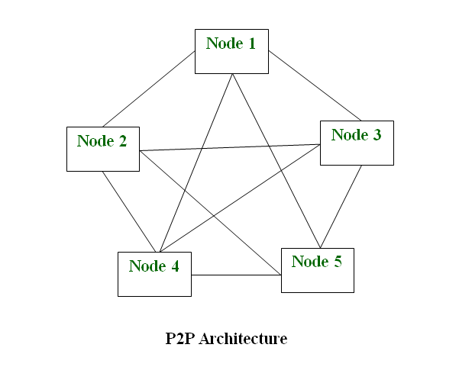
Types of P2P networks
Unstructured P2P networks: In this type of P2P network, each device is able to make an equal contribution. This network is easy to build as devices can be connected randomly in the network. But being unstructured, it becomes difficult to find content. For example, Napster, Gnutella, etc.
Structured P2P networks: It is designed using software that creates a virtual layer in order to put the nodes in a specific structure. These are not easy to set up but can give easy access to users to the content. For example, P-Grid, Kademlia, etc.
Hybrid P2P networks: It combines the features of both P2P networks and client-server architecture. An example of such a network is to find a node using the central server.

Slide 21
CCS335 CLOUD COMPUTING
How Does P2P Network Work?
Let’s understand the working of the Peer-to-Peer network through an example. Suppose, the user wants to download a file through the peer-to-peer network then the download will be handled in this way:
If the peer-to-peer software is not already installed, then the user first has to install the peer-to-peer software on his computer.
This creates a virtual network of peer-to-peer application users.
The user then downloads the file, which is received in bits that come from multiple computers in the network that have already that file.
The data is also sent from the user’s computer to other computers in the network that ask for the data that exist on the user’s computer.
Thus, it can be said that in the peer-to-peer network the file transfer load is distributed among the peer computers.
How to Use a P2P Network Efficiently?
Firstly secure your network via privacy solutions. Below are some of the measures to keep the P2P network secure:
Share and download legal files: Double-check the files that are being downloaded before sharing them with other employees. It is very important to make sure that only legal files are downloaded.
Design strategy for sharing: Design a strategy that suits the underlying architecture in order to manage applications and underlying data.

Slide 22
Keep security practices up-to-date: Keep a check on the cyber security threats which might prevail in the network. Invest in good quality software that can sustain attacks and prevent the network from being exploited. Update your software regularly.
Scan all downloads: This is used to constantly check and scan all the files for viruses before downloading them. This helps to ensure that safe files are being downloaded and in case, any file with potential threat is detected then report to the IT Staff.
Proper shutdown of P2P networking after use: It is very important to correctly shut down the software to avoid unnecessary access to third persons to the files in the network. Even if the windows are closed after file sharing but the software is still active then the unauthorized user can still gain access to the network which can be a major security breach in the network.
Applications of P2P Network
Below are some of the common uses of P2P network:
File sharing: P2P network is the most convenient, cost-efficient method for file sharing for businesses. Using this type of network there is no need for intermediate servers to transfer the file.
Direct messaging: P2P network provides a secure, quick, and efficient way to communicate. This is possible due to the use of encryption at both the peers and access to easy messaging tools.
Collaboration: The easy file sharing also helps to build collaboration among other peers in the network.
File sharing networks: Many P2P file sharing networks like G2, and eDonkey have popularized peer-to-peer technologies.
Content distribution: In a P2P network, unlike the client-server system so the clients can both provide and use resources. Thus, the content serving capacity of the P2P networks can actually increase as more users begin to access the content.

Slide 23
IP Telephony: Skype is one good example of a P2P application in VoIP.
Advantages of P2P Network
Easy to maintain: The network is easy to maintain because each node is independent of the other.
Less costly: Since each node acts as a server, therefore the cost of the central server is saved. Thus, there is no need to buy an expensive server.
No network manager: In a P2P network since each node manages his or her own computer, thus there is no need for a network manager.
Adding nodes is easy: Adding, deleting, and repairing nodes in this network is easy.
Less network traffic: In a P2P network, there is less network traffic than in a client/ server network.
Disadvantages of P2P Network
Data is vulnerable: Because of no central server, data is always vulnerable to getting lost because of no backup.
Less secure: It becomes difficult to secure the complete network because each node is independent.
Slow performance: In a P2P network, each computer is accessed by other computers in the network which slows down the performance of the user.
Files hard to locate: In a P2P network, the files are not centrally stored, rather they are stored on individual computers which makes it difficult to locate the files.

Slide 24
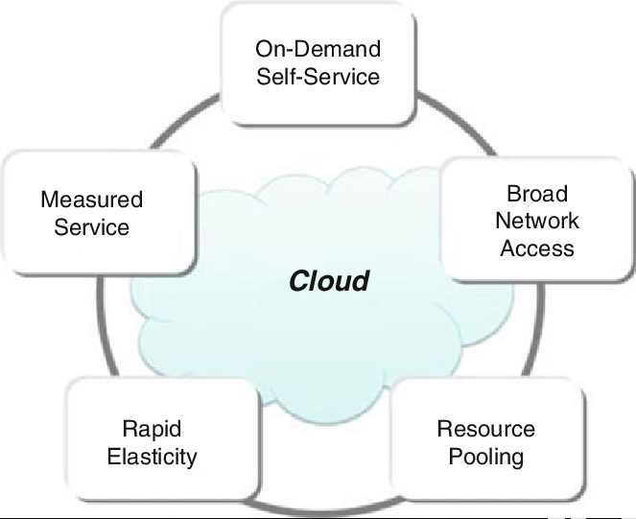
what is cloud computing? https://youtu.be/_a6us8kaq0g?si=JoFrH3y9LcG4KBEh –cloud computing
Cloud computing is the delivery of different services through the Internet, including data storage, servers, databases, networking, and software. Cloud storage has grown increasingly popular among individuals who need larger storage space and for businesses seeking an efficient off-site data back-up solution.
Cloud computing also allows businesses to access and manage resources and applications wherever there is an internet connection, much like how you can check your email inbox online through a web browser.
Characteristics of cloud computing https://youtu.be/M988_fsOSWo?si=hABo2BuumF4RbZ3w –cloud computing

Slide 25
On-demand self-services: The Cloud computing services does not require any human administrators, user themselves are able to provision, monitor and manage computing resources as needed.
Broad network access: The Computing services are generally provided over standard networks and heterogeneous devices.
Rapid elasticity: The Computing services should have IT resources that are able to scale out and in quickly and on as needed basis. Whenever the user require services it is provided to him and it is scale out as soon as its requirement gets over.
Resource pooling: The IT resource (e.g., networks, servers, storage, applications, and services) present are shared across multiple applications and occupant in an uncommitted manner. Multiple clients are provided service from a same physical resource.
Measured service: The resource utilization is tracked for each application and occupant, it will provide both the user and the resource provider with an account of what has been used. This is done for various reasons like monitoring billing and effective use of resource.
Advantages of CC
1. Flexibility https://youtu.be/C80hIkAK4FI?si=qc7ARdsPjVvifASL – cloud computing in tamil
One major advantage of cloud computing is that it gives businesses more flexibility. With it, organisations can quickly scale resources and storage up to satisfy business demands without investing in physical infrastructure.
In the same way, if resources are not being used, they can scale back instantly because there are no low bandwidth limitations on the cloud.
Cloud computing is more adaptable than the in-house technical infrastructure, allowing companies to make last-minute changes while maintaining productivity.

Slide 26
3. Data Security
Cloud computing features strong encryption on files and databases that can reduce the susceptibility to hacker attacks.
4. Automatic Updates
Cloud computing simplifies the process of regularly updating your Software or firmware. You no longer need to be concerned about manually updating your Software because the cloud handles everything.
Due to cyclical upgrades and automatic software repairs, users can now concentrate their time and energy on work. Also, business IT departments are no longer required to update the Software manually. This saves time and money that would have been used for outside IT advice.
Cons of Cloud Computing https://youtu.be/bVcYau9TmnA?si=d_E_Y0WH3ADevKcx cloud computing in tamil
Here are some of the disadvantages of Cloud Computing:
1. Internet Connectivity: Cloud computing's primary drawback is the necessity for an internet connection. In on-demand computing, all information (including images, music, and video) is kept in the cloud and accessed online. This means you require a good internet connection anytime you want to access these files or cannot view the data.
2. Downtime: Another major disadvantage of cloud computing is downtime. Cloud providers are susceptible to technical issues due to several causes, including power outages, poor Internet connectivity, the need for maintenance at data centres, etc. This might cause the online service to experience a brief outage.
3. Limited Control: Since cloud users have less influence over how the services within a cloud infrastructure operate and are delivered, it is essential to note that the service provider owns, controls, and monitors cloud infrastructure.

